Slide 1

“A PROJECT REPORT ON REVIEW RATING PREDICTION”
SUBMITTED BY
HIMAJA IJJADA
Caution - Please view the presentation as a slide show for better experience

Slide 2
TOPICS TO BE DISCUSSED
Introduction
Problem statement
Conceptual Background of the Domain Problem
Motivation for the Problem Undertaken
Mathematical/ Analytical Modeling of the Problem
Data Sources and their formats
Data Preprocessing Done
Software Used
Visualizations
Model/s Development and evaluation
Interpretation of the Results
Key Findings and Conclusions of the Study

Slide 3
Introduction
Rating prediction is a well-known recommendation task aiming to predict a user’s rating for those items which were not rated yet by her. Predictions are computed from users’ explicit feedback, i.e. their ratings provided on some items in the past. Another type of feedback are user reviews provided on items which implicitly express users’ opinions on items. Recent studies indicate that opinions inferred from users’ reviews on items are strong predictors of user’s implicit feedback or even ratings and thus, should be utilized in computation.
The rise in E-commerce has brought a significant rise in the importance of customer reviews. There are hundreds of review sites online and massive amounts of reviews for every product. Customers have changed their way of shopping and according to a recent survey, 70 percent of customers say that they use rating filters to filter out low rated items in their searches. The ability to successfully decide whether a review will be helpful to other customers and thus give the product more exposure is vital to companies that support these reviews, companies like Google, Amazon and Yelp!. There are two main methods to approach this problem. The first one is based on review text content analysis and uses the principles of natural language process (the NLP method). This method lacks the insights that can be drawn from the relationship between costumers and items. The second one is based on recommender systems, specifically on collaborative filtering, and focuses on the reviewer’s point of view.

Slide 4
Problem statement
We have a client who has a website where people write different reviews for technical products. Now they are adding a new feature to their website i.e. the reviewer will have to add stars (rating) as well with the review. The rating is out 5 stars and it only has 5 options available 1 star, 2 stars, 3 stars, 4 stars, 5 stars.
Now they want to predict ratings for the reviews which were written in the past and they don’t have rating. So we, we have to build an application which can predict the rating by seeing the review.

Slide 5
Conceptual Background of the Domain Problem
Recommendation systems are an important units in today's e-commerce applications, such as targeted advertising, personalized marketing and information retrieval. In recent years, the importance of contextual information has motivated generation of personalized recommendations according to the available contextual information of users. Compared to the traditional systems which mainly utilize user’s rating history, review-based recommendation hopefully provide more relevant results to users. We introduce a review-based recommendation approach that obtains contextual information by mining user reviews. The proposed approach relate to features obtained by analyzing textual reviews using methods developed in Natural Language Processing (NLP) and information retrieval discipline to compute a utility function over a given item.
An item utility is a measure that shows how much it is preferred according to user's current context. In our system, the context inference is modelled as similarity between the user’s reviews history and the item reviews history. As an example application, we used our method to mine contextual data from customer’s reviews of technical products and use it to produce review-based rating prediction. The predicted ratings can generate recommendations that are item-based and should appear at the recommended items list in the product page. Our evaluations (surprisingly) suggest that our system can help produce better prediction rating scores in comparison to the standard prediction methods.
As far as we know, all the recent works on recommendation techniques utilizing opinions inferred from user’s reviews are either focused on the item recommendation task or use only the opinion information, completely leaving user’s ratings out of consideration. The approach proposed in this report is filling this gap, providing a simple, personalized and scalable rating prediction framework utilizing both ratings provided by users and opinions inferred from their reviews. Experimental results provided on dataset containing user ratings and reviews from the real world Amazon and Flipkart Product Review Data show the effectiveness of the proposed framework.

Slide 6
Motivation for the Problem Undertaken
The project was provided to me by FlipRobo as a part of the internship program. The exposure to real world data and the opportunity to deploy my skillset in solving a real time problem has been the primary objective. Many product reviews are not accompanied by a scale rating system, consisting only of a textual evaluation. In this case, it becomes daunting and time-consuming to compare different products in order to eventually make a choice between them.
Therefore, models able to predict the user rating from the text review are critically important. Getting an overall sense of a textual review could in turn improve consumer experience. However, the motivation for taking this project was that it is relatively a new field of research. Here we have many options but less concrete solutions. The main motivation is to build a prototype of online hate and abuse review classifier which can used to classify hate and good comments so that it can be controlled and corrected according to the reviewer’s choice.

Slide 7
Mathematical/ Analytical Modeling of the Problem
In this problem the Ratings can be 1, 2, 3, 4 or 5, which represents the likely ness of the product to the customer. So clearly it is a multi-classification problem and I have to use all classification algorithms while building the model. We would perform one type of supervised learning algorithms: Classification. Here, we will only perform classification. Since there only 1 feature in the dataset, filtering the words is needed to prevent overfitting. In order to determine the regularization parameter, throughout the project in classification part, we would first remove email, phone number, web address, spaces and stops words etc. In order to further improve our models, we also performed TFID in order to convert the tokens from the train documents into vectors so that machine can do further processing. I have used all the classification algorithms while building model then tuned the best model and saved the best model.
I will need to build multiple classification machine learning models. Before model building will need to perform all data pre-processing steps involving NLP. After trying different classification models with different hyper parameters then will select the best model out of it. Will need to follow the complete life cycle of data science that includes steps like -
1. Data Cleaning
2. Exploratory Data Analysis
3. Data Pre-processing
4. Model Building
5. Model Evaluation
6. Selecting the best model
Finally, we compared the results of proposed and baseline features with other machine learning algorithms. Findings of the comparison indicate the significance of the proposed features in review rating prediction.

Slide 8
Data Analysis steps :
Import Libraries
Import Dataset
Data Pre Processing
Ordinal encoding
Visualization
Finding null values

Slide 9
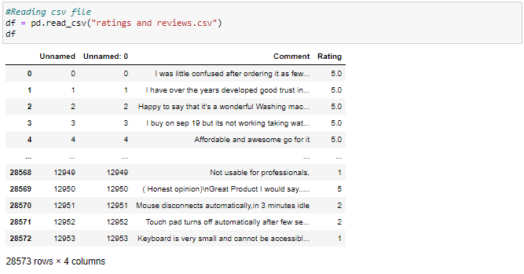
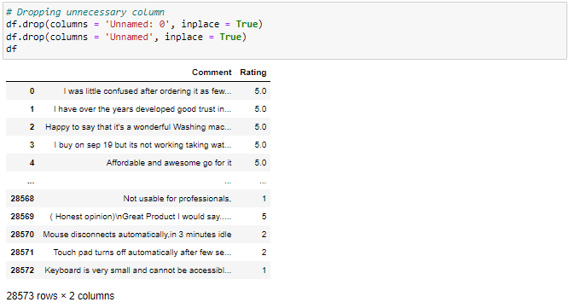
Data Sources and their formats
The data set contains nearly 28573 samples with 2 features. Since Rating is my target column and it is a categorical column with 5 categories, this problem is a Multi Classification Problem. The Ratings can be 1, 2, 3, 4 or 5, which represents the likeliness of the product to the customer. The data set includes:
Comment: Text Content of the Review.
Rating: Ratings out of 5 stars.
This project is more about exploration, feature engineering and classification that can be done on this data. Since the data set is huge and includes multi classification of ratings, we can do good amount of data exploration and derive some interesting features using the Review column available. We need to build a model that can predict Ratings of the review.

Slide 10
Data Preprocessing Done

Slide 15
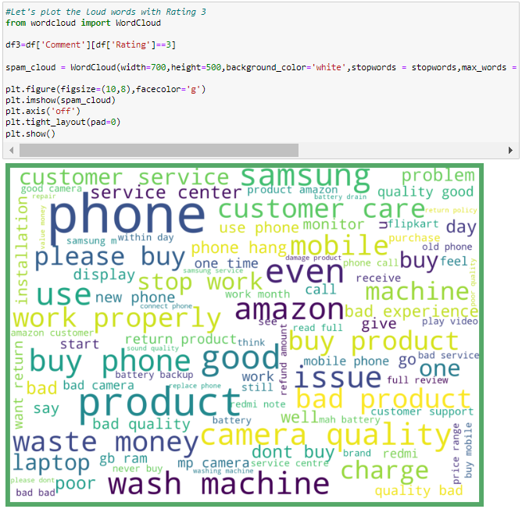
Assumptions
- From the above plots we can clearly see the words which are indication of Reviewer's opinion on products.
- Here most frequent words used for each Rating is displayed in the word cloud.

Slide 16
Software Used
Distribution: Anaconda Navigator
Programming language: Python
Browser based language shell: Jupyter Notebook
Word cloud: For visual display of text data
Libraries/Packages specifically being used - Pandas, NumPy, matplotlib, seaborn, scikit-learn, pandas-profiling, missingno, NLTK

Slide 17
Visualizations

Slide 18
Model/s Development and evaluation

Slide 22
Interpretation of the Results

Slide 23
Key Findings and Conclusions of the Study
In this project I have collected data of reviews and ratings for different products from amazon.in and flipkart.com.
we have tried to detect the Ratings in commercial websites on a scale of 1 to 5 on the basis of the reviews given by the users. We made use of natural language processing and machine learning algorithms in order to do so.
Then I have done different text processing for reviews column and chose equal number of text from each rating class to eliminate problem of imbalance. By doing different EDA steps I have analyzed the text.
We have checked frequently occurring words in our data as well as rarely occurring words.
After all these steps I have built function to train and test different algorithms and using various evaluation metrics I have selected SGD Classifier for our final model.
Finally by doing hyperparameter tuning we got optimum parameters for our final model.

Slide 24
Learning Outcomes of the Study in respect of Data Science
I have scrapped the reviews and ratings of different technical products from flipkart.com and amazon.in websites. Improvement in computing technology has made it possible to examine social information that cannot previously be captured, processed and analyzed. New analytical techniques (NLP) of machine learning can be used in property research. The power of visualization has helped us in understanding the data by graphical representation it has made me to understand what data is trying to say. Data cleaning is one of the most important steps to remove unrealistic values, punctuations, URLs, email address and stop words. This study is an exploratory attempt to use 6 machine learning algorithms in estimating Rating, and then compare their results.
To conclude, the application of NLP in rating classification is still at an early stage. We hope this study has moved a small step ahead in providing some methodological and empirical contributions to crediting institutes, and presenting an alternative approach to the valuation of Ratings.
In this project we were able to learn various Natural language processing techniques like lemmatization, stemming, removal of Stop words. This project has demonstrated the importance of sampling effectively, modelling and predicting data. Through different powerful tools of visualization we were able to analyses and interpret different hidden insights about the data. The few challenges while working on this project are:-
Imbalanced dataset
Lots of text data

Slide 25
Thank you

